Slide 1


EXPLORATORY PROJECT REPORT To make a real time hand gesture controller for drone which is robust in any environmental changes.
Submitted by:
Yash Upadhyay (19095111)
Yatharth Bhargava (19095112)
Under the Guidance of
Dr. Sanjeev Sharma
(Department of Electronics Engineering)

Slide 2
Overview
The aim of this project is to make a real time hand gesture controller for drone which is robust in any environmental changes.
For hand localisation and gesture detection we have used “MediaPipe” pipeline which uses two models on for hand localization and one for gesture detection.
For showing drone control and motion according to hand gesture we have used CoppeliaSim simulator and developed our own motion control code.

Slide 3
Convolutional Neural Network
Most of the Computer Vision tasks are surrounded around CNN architectures, as the basis of most of the problems is to classify an image into known labels.
Algorithms for object detection like SSD(single shot multi-box detection) and YOLO(You Only Look Once) are also built around CNN.
Our implementation uses SSD algorithm.
SSD is designed for object detection in real-time. Faster R-CNN uses a region proposal network to create boundary boxes and utilizes those boxes to classify objects.
The SSD object detection composes of 2 parts:
a) Extract feature maps.
b) Apply convolution filters to detect objects.
SSD uses VGG16 to extract feature maps. Then it detects objects using the Conv4_3 layer.

Slide 4

Mediapipe offers cross-platform, customizable ML solutions for live and streaming media.
MediaPipe Hands is a high-fidelity hand and finger tracking solution. It employs machine learning (ML) to infer 21 3D landmarks of a hand from just a single frame.
Whereas current state-of-the-art approaches rely primarily on powerful desktop environments for inference, this method achieves real-time performance on a mobile phone, and even scales to multiple hands.

Slide 5
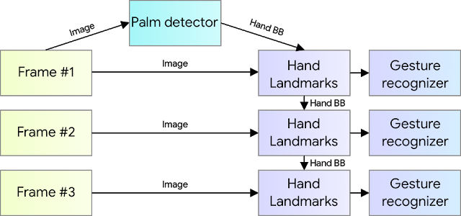
Mediapipe
MediaPipe Hands utilizes an ML pipeline consisting of multiple models working together: A palm detection model that operates on the full image and returns an oriented hand bounding box. A hand landmark model that operates on the cropped image region defined by the palm detector and returns high-fidelity 3D hand keypoints.

Slide 6
Mediapipe
Providing the accurately cropped hand image to the hand landmark model drastically reduces the need for data augmentation (e.g., rotations, translation and scale) and instead allows the network to dedicate most of its capacity towards coordinate prediction accuracy.
In addition, in the pipeline the crops can also be generated based on the hand landmarks identified in the previous frame, and only when the landmark model could no longer identify hand presence is palm detection invoked to re-localize the hand.

Slide 7
Mediapipe – Palm Detection Model
Mediapipe method addresses the challenge of detecting palm using different strategies. First, a palm detector is trained instead of a hand detector, since estimating bounding boxes of rigid objects like palms and fists is significantly simpler than detecting hands with articulated fingers.
In addition, as palms are smaller objects, the non-maximum suppression algorithm works well even for two-hand self-occlusion cases, like handshakes.
Also, an encoder-decoder feature extractor is used for bigger scene context awareness even for small objects (similar to the RetinaNet approach).

Slide 8

Mediapipe – Hand landmark model
After the palm detection over the whole image the subsequent hand landmark model performs precise keypoint localization of 21 3D hand-knuckle coordinates inside the detected hand regions via regression, that is direct coordinate prediction.
The model learns a consistent internal hand pose representation and is robust even to partially visible hands and self-occlusions.

Slide 9
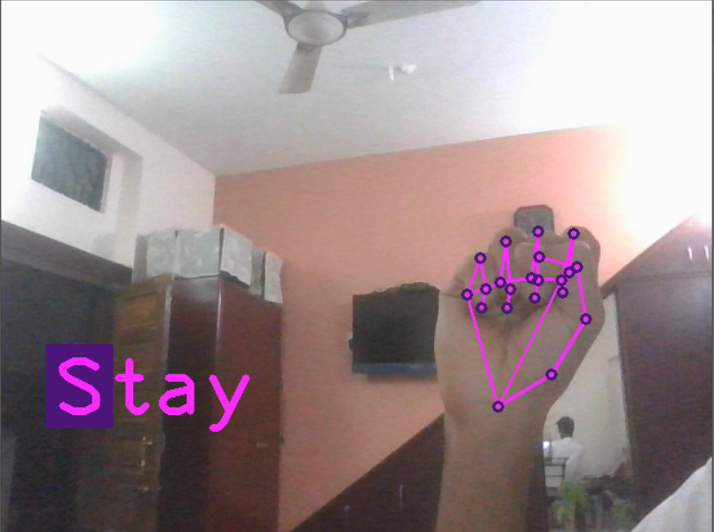
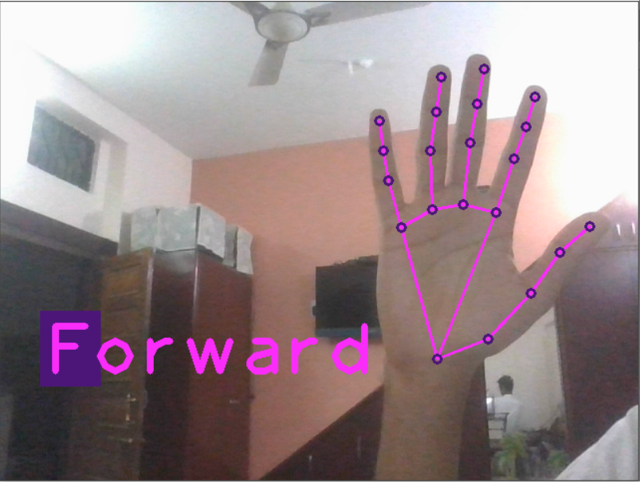
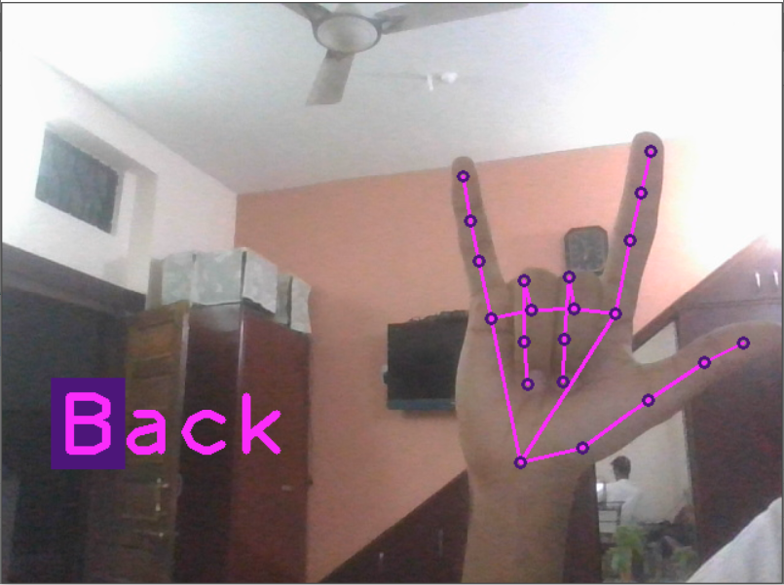
Our Approach
Hand Tracking and Landmark Detection
Control Logic to Control Drone
Controlling Drone in Simulator Using Script in Simulator

Slide 10
Control Logic
We have implemented 2 logic to control drone.
Finger – count Approach
Hand Position Based Approach
Commands from this logic is fed into the script in simulation software, where the drone maneuver accordingly.

Slide 11
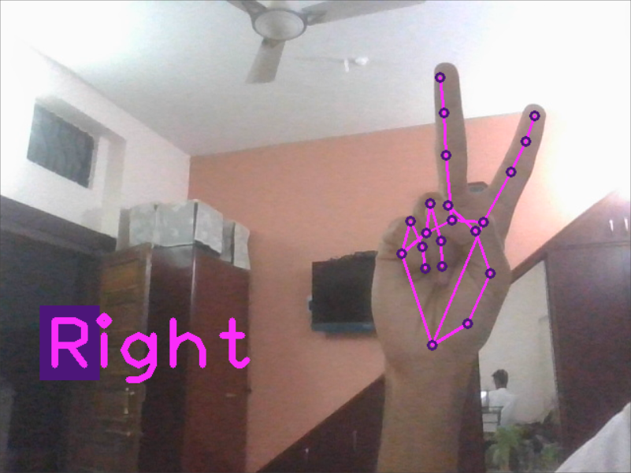
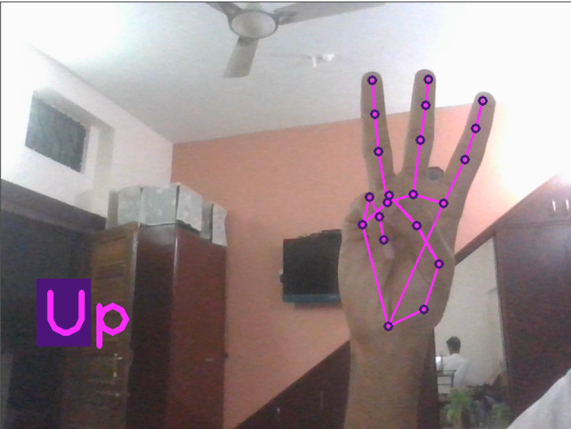
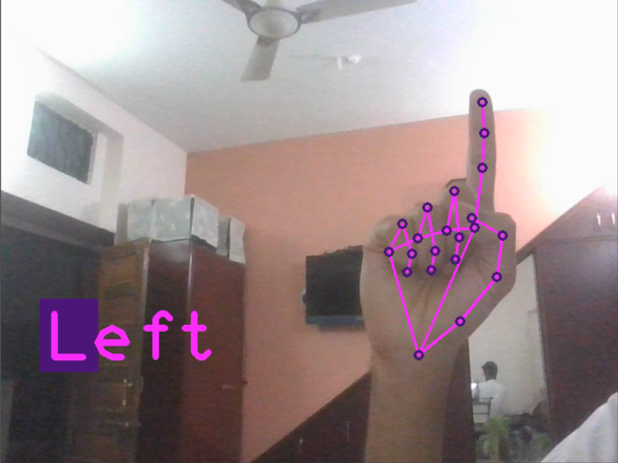
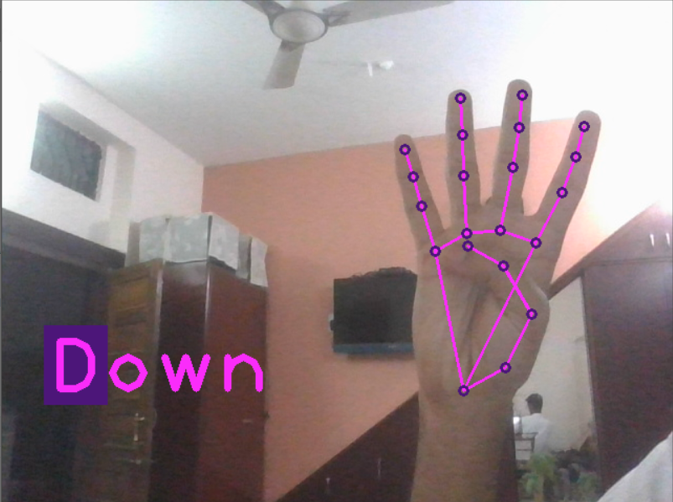
Finger Count Approach
Basically in this method we have the drone maneuver depends on the count of the number of fingers and thumb erect. Below are some images of commands:
vxc
Open Hand :
Forward
Two Fingers :
Right
Three Fingers :
Upwards
Yo sign :
Back
One Finger :
Left
Four Fingers :
Downwards
Close Hand :
Stay

Slide 12
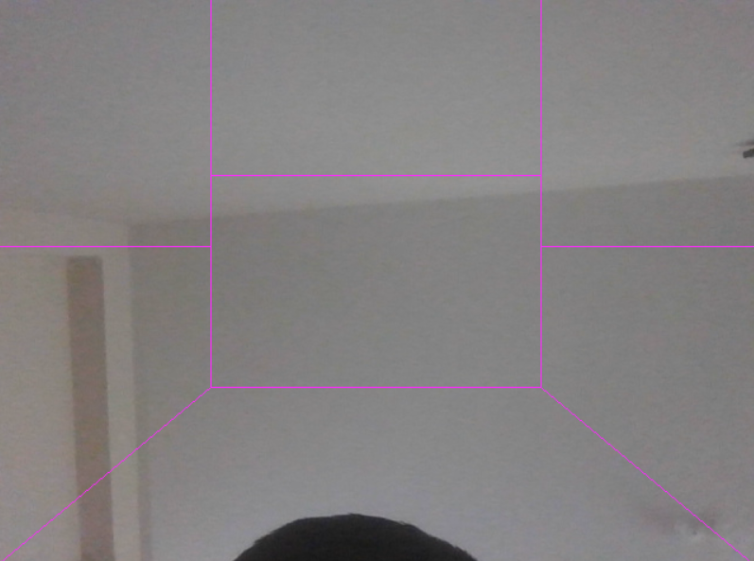
Hand Position Based Approach
In this method we have the drone maneuver depends on the position of hand and its orientation in the frame of camera feed. Below is sample of range. Position of Hand is characterized by coordinates of landmark number 9 and 13 of detected hand.
LEFT
ROTATION
UP
RIGHT
ROTATION
FORWARD/
BACKWARD
LEFT
RIGHT
DOWN

Slide 13
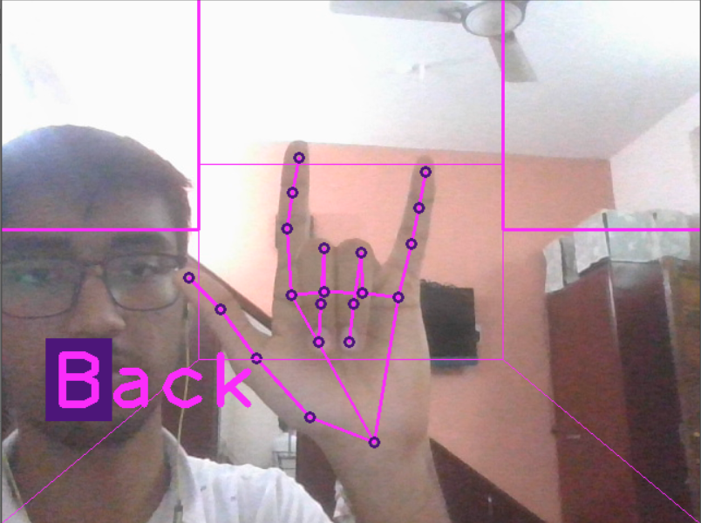
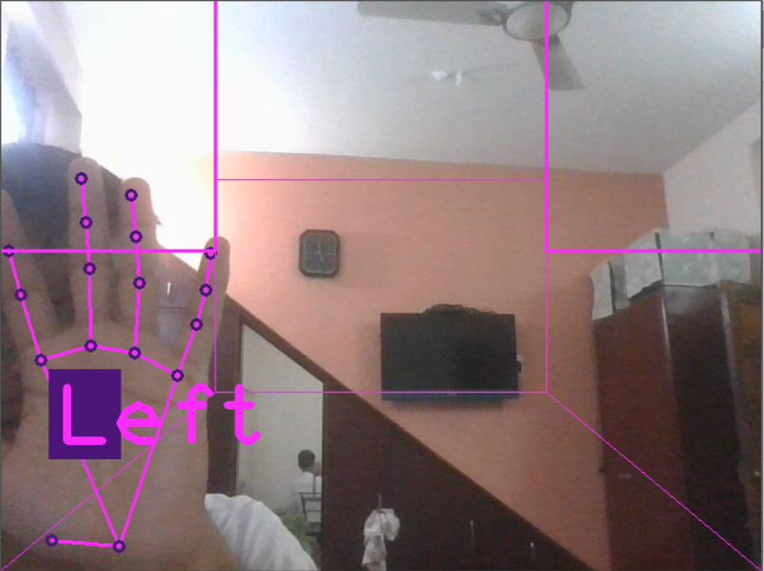
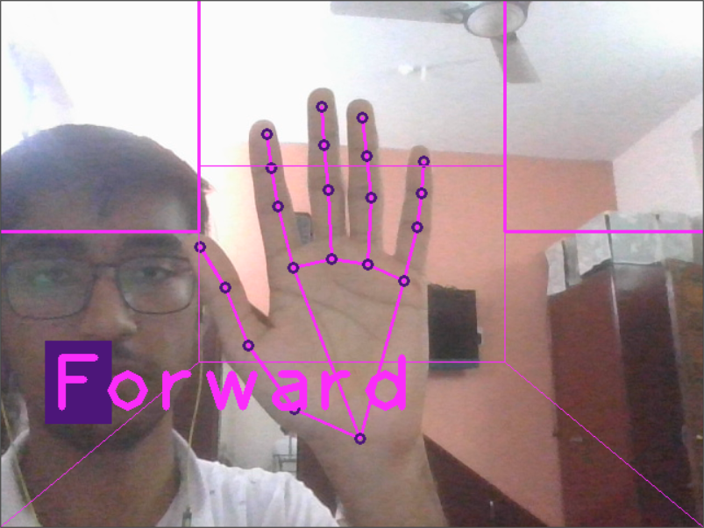
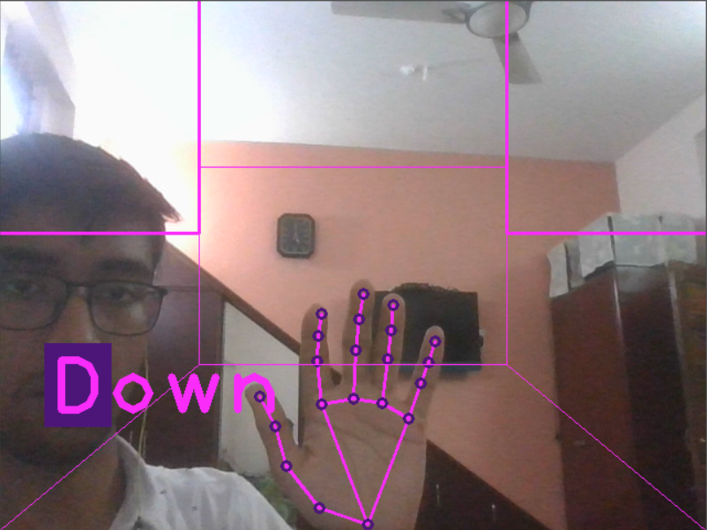
Some Examples

Slide 14
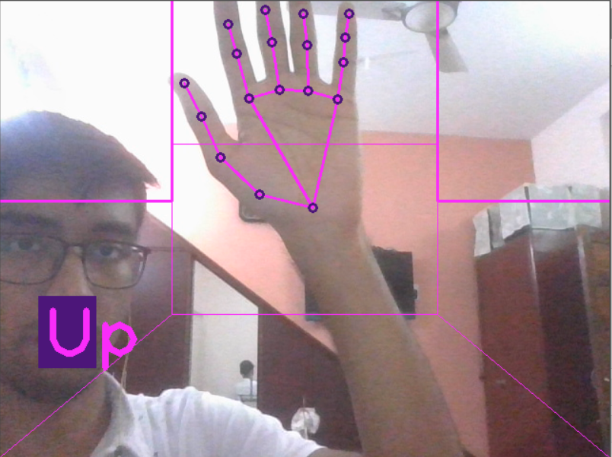
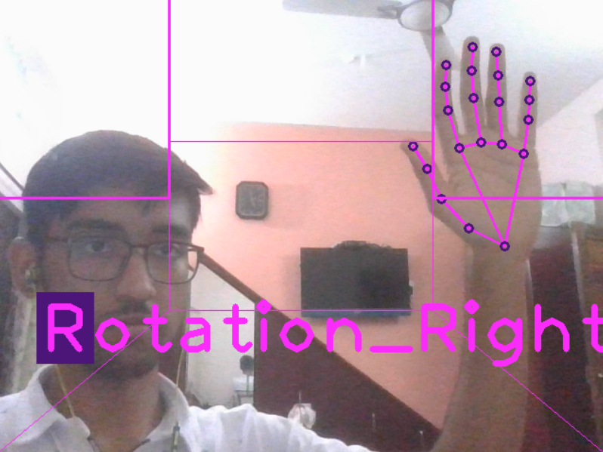
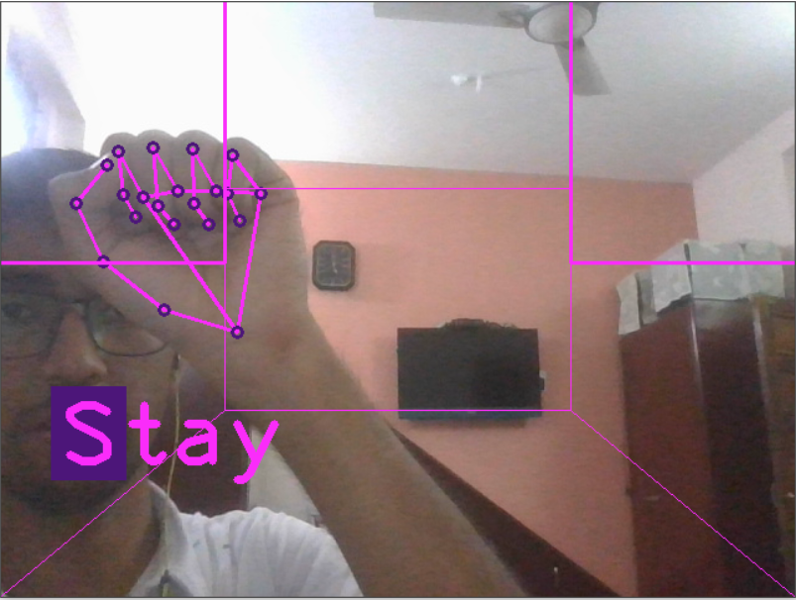
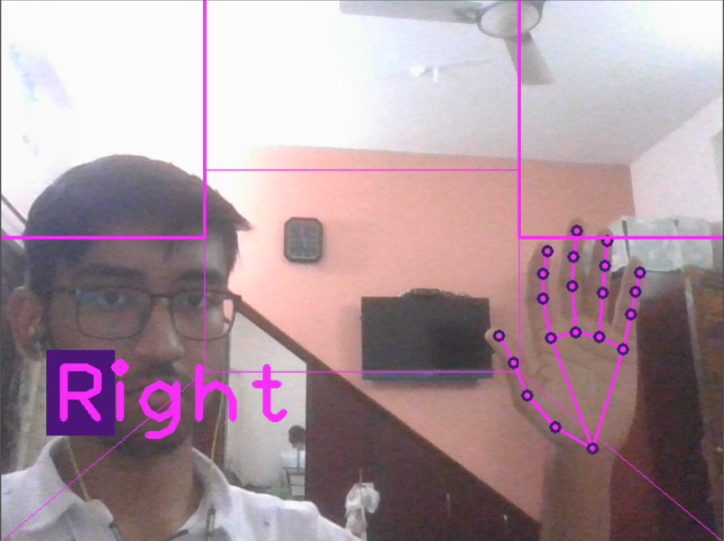
Some Examples

Slide 15

Drone Simulation software
We In this project used Coppeliasim due to following reasons:
It is based on a distributed control architecture: each object/model can be individually controlled via an embedded script, a plugin, a ROS, a remote API client, or a custom solution.
Its compatibility with both Windows and linux.
Multiple language support for controller.
Fast and lightweight.
Small size and ease of installation.
Its large support base and proper documentation.

Slide 16
Results and Discussions
Machine Learning and Computer Vision-based method for drone control is very simplistic and beginner friendly also it adds new features to drone such as one-handed control and performing very touch stunts just using simple gesture. But Practical application and simulation testing are two different systems.
Of course, there is one particular limitation that we immediately noticed when compared to using a remote control that seemed to be a disadvantage to our solution. That limitation would be the latency with which the signal is received. In particular, there is much more computation going on when it comes to the two forms of operating the drone.

Slide 17
Summary and Conclusion
To conclude, our project is going to be a new way to interact with drones and can pave the way for a new way to interact with other machines as well. The extensibility of gesture-controlled devices is rapidly growing, and it is also extremely beneficial to those with disabilities regarding sound. Because those with disabilities regarding sound tend to communicate through sign language or the like because they are unable to talk, this will allow them an easy way to communicate with devices via gestures that they are already very familiar with. Our project, a gesture-operated drone, is simply an implementation of a gesture-controlled device. The Gesture Operated Drone allows for an extremely simple way to operate a drone in comparison to the unwieldy RC remotes that commonly come with drones to operate them.

Slide 18
References
https://mediapipe.dev/
https://www.coppeliarobotics.com/
https://www.researchgate.net/publication/324485264_Hand_Gesture_Controlled_Drones_An_Open_Source_Library
https://medium.com/alumnaiacademy/introduction-to-computer-vision-4fc2a2ba9dc
https://www.ece.ucf.edu/seniordesign/su2019fa2019/g03/Documents/GOD_Senior_Design_1Final_Document_Group3.pdf
Sensors | Free Full-Text | Real-Time Human Detection and Gesture Recognition for On-Board UAV Rescue (mdpi.com)

